Slide 1
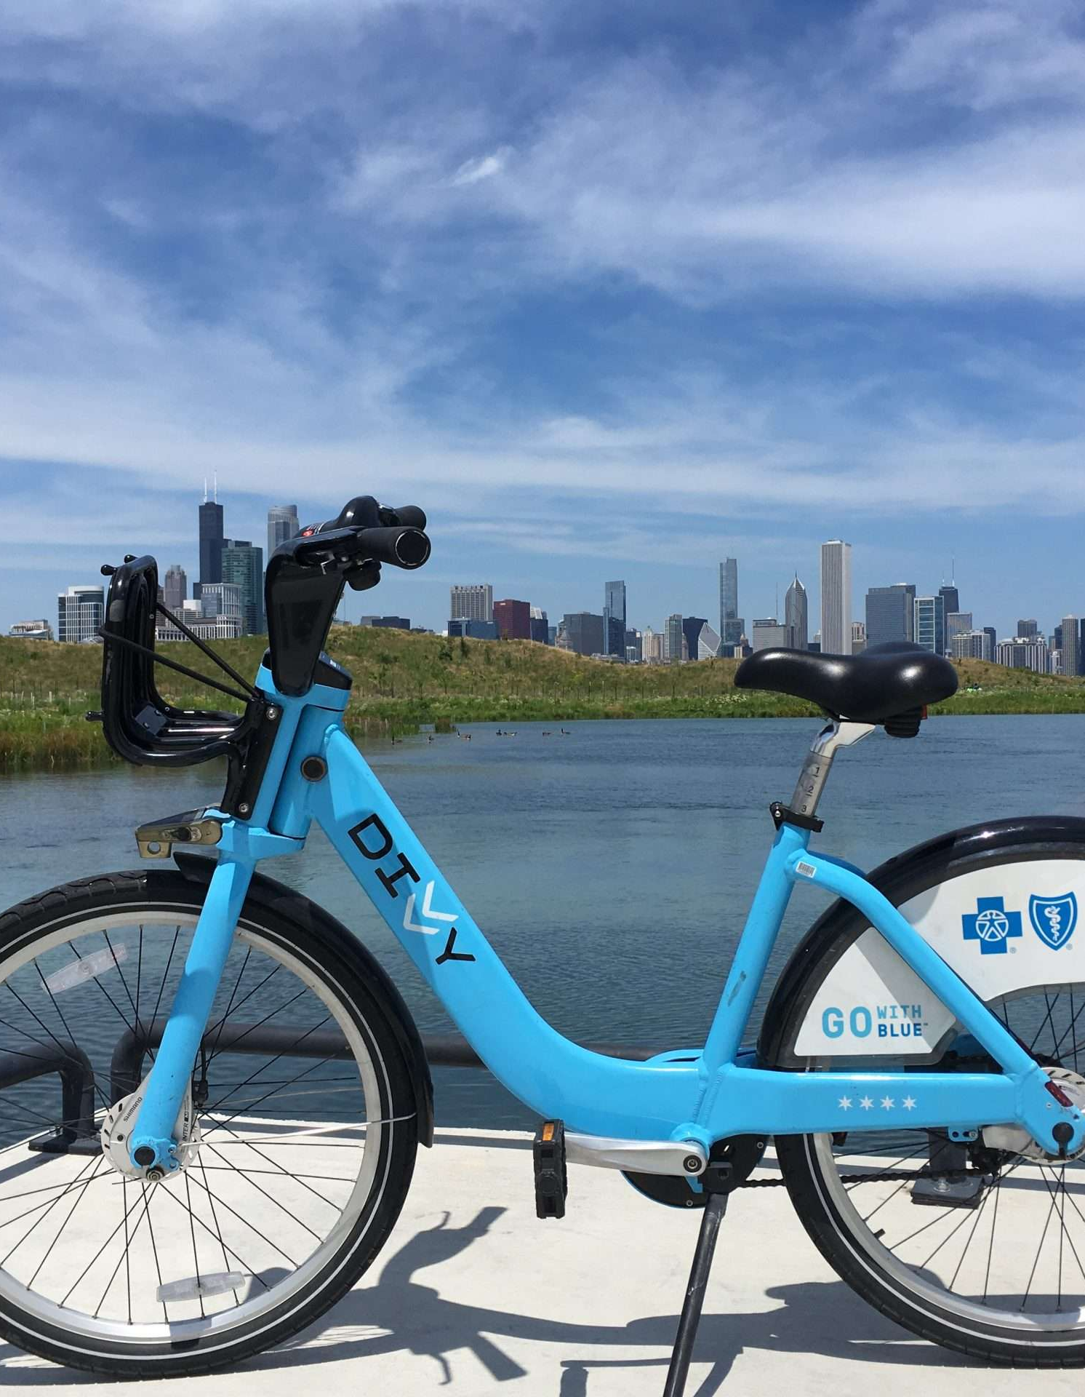
Pedal & Explore – From Casual Rides to Urban Adventures
Recommendations for Converting Casual Riders to Long-Term Customers
Donnie Minnick
January 2024
Notes:
Welcome, stakeholders, to an exploration of strategic shifts in converting casual riders into annual members within the realm of urban cycling. Today, we dissect the intersection of convenience and adventure offered by Cyclistic's bike-sharing service.
In our pursuit of profitability, we unveil tactics to transition casual riders into committed, year-long adventurers. As we navigate this journey, we'll focus on leveraging urban exploration as the key driver for annual memberships.
Join me as we analyze data-driven strategies and innovative approaches, positioning Cyclistic as not just a transportation solution but as an enabler of continuous urban discovery. Let's propel casual cyclists into a realm of long-term commitment and sustained business growth.

Slide 2
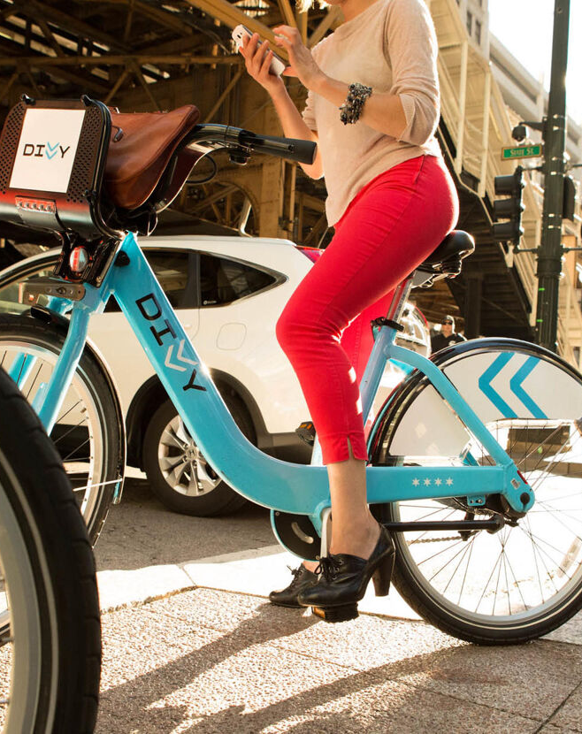
Agenda
Introduction
Business Task
Insights
Recommendations
Next Steps

Slide 3
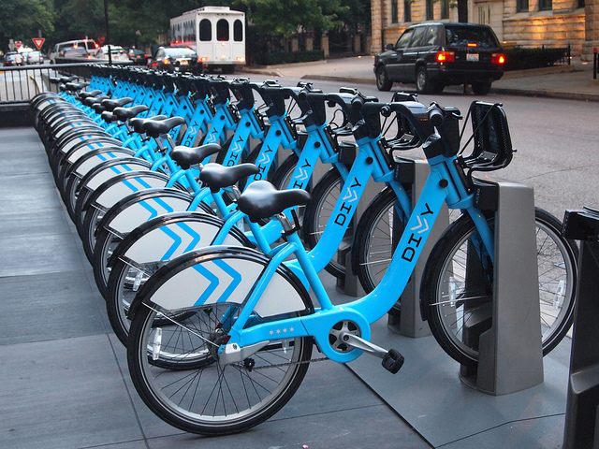
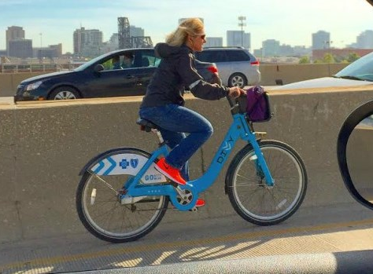
Introduction
Cyclistic, a Chicago-based bike-sharing company, operates a geotracked fleet of bicycles available throughout the city.
Cyclistic classifies riders into two types: casual riders, who purchase single-ride or full-day passes, and members that subscribe to annual memberships.
While offering flexible purchase options attracts customers, Cyclistic's finance department has concluded that members are more profitable than casual riders and need insights to help them develop a conversion strategy.

Slide 4
Business Task
Cyclistic's marketing team plans to develop marketing strategies to increase profits by converting casual riders to annual members. To help the marketing team understand this opportunity, analysis will focus on three questions.
How do annual members and casual riders differ?
Why might casual riders buy an annual membership?
How might Cyclistic use digital media to influence casual riders to become members?

Slide 5
Notes on Source Data
Used first-party data from Cyclistic that captures individual trip details.
Covers same-day trips taken between January 1, 2022 and December 31, 2022.
Used random sample of 250,000 trips from population of 5,600,000.
Data cleaned and transformed to address missing values, inconsistencies, duplicates and create categorical variables for analysis.
Supplemented with shape files from the Chicago Data Portal for geographical analysis.
Notes:
Captured detailed end-to-end workflow and analysis steps in series of R markdown notebooks for reproducibility. Notebooks contain all code and outputs used to generate analysis and insights. Notebooks are organized by phase: 1) ask, 2) prepare, 3) process, 4) analyze, and 5) share and act.

Slide 6
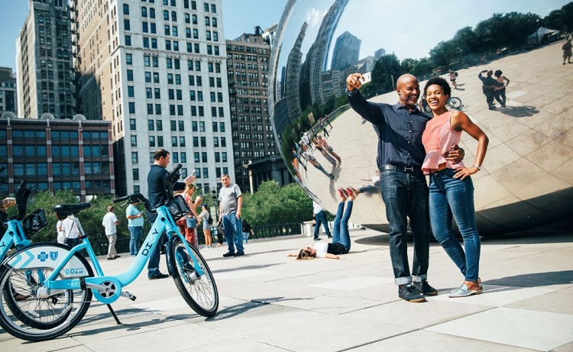
Insights
Why might casual riders buy an annual membership?
Why might casual riders buy an annual membership?
How might Cyclistic use digital media to influence casual riders to become members?

Slide 7
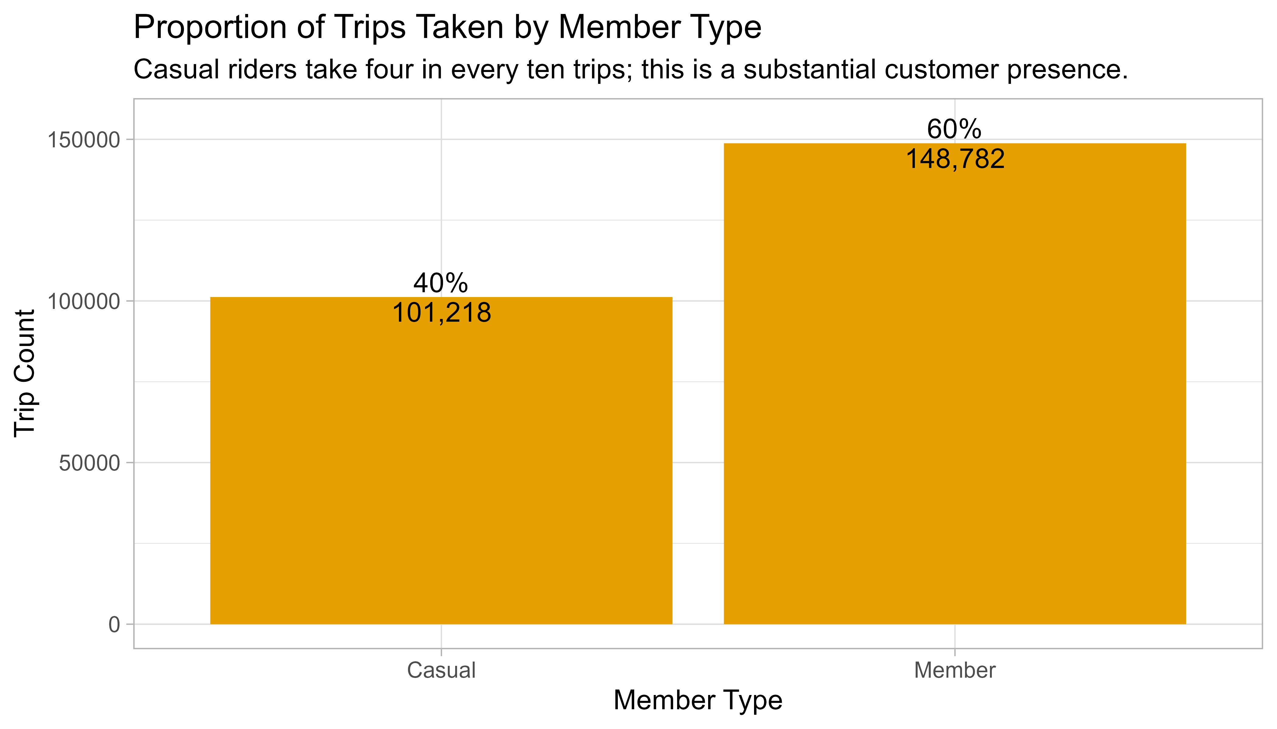
Four in every ten trips are taken by casual riders
Notes:
Observations
Four in every ten trips (40%) are taken by casual riders. The 40% proportion indicates a substantial presence of casual riders within the customer base.
This suggests that a considerable portion of Cyclistic's customers prefer a pay-as-you-go or occasional usage model rather than committing to a long-term membership.
Annual members, constituting 60% of the trips, are more actively engaged with the bike-sharing service. This higher proportion could indicate that annual members use the service more consistently or for a broader range of purposes.
Opportunities
Considering the proportion of casual riders, Cyclistic might explore introducing flexible membership options that appeal to users who prefer occasional rides. This flexibility can enhance the service's attractiveness to a broader audience.

Slide 8
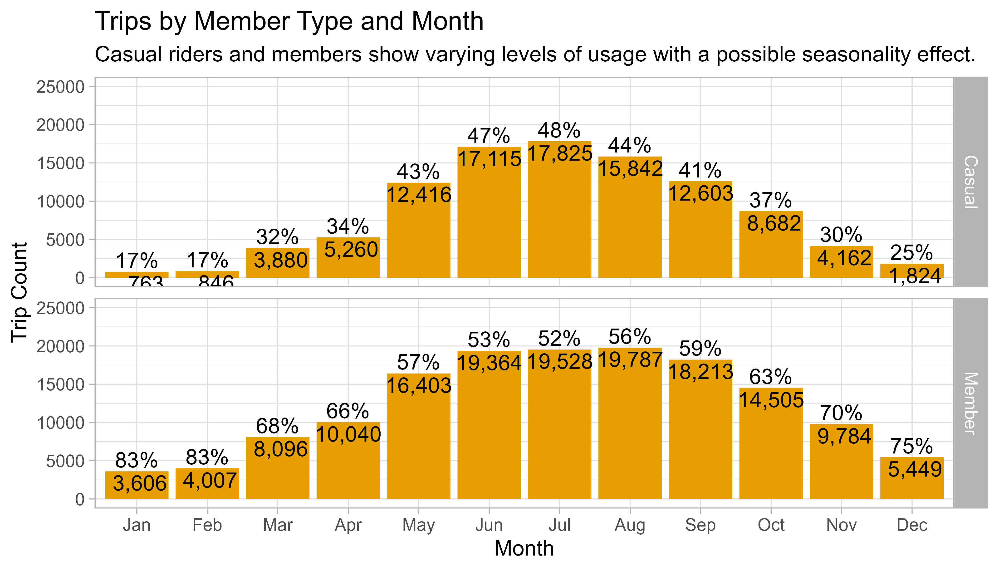
Engagement with the service is strongest in the summer months
Notes:
Observations
From January to December, both casual riders and members show varying levels of usage.
There seems to be a trend of increased usage, especially by members, during the warmer months (e.g., May to September), suggesting a possible seasonality effect where people are more inclined to use bike-sharing services in favorable weather.
Throughout the entire year, members consistently contribute to the majority of trips, with proportions ranging from 52% to 83%.
Casual ridership varies more compared to members, showing peaks and troughs throughout the year. The proportion of trips taken by casual riders ranges from 17% to 48%, suggesting fluctuations in the demand from this group.
Opportunities
Months where member usage is rising or particularly high can serve as opportunities to focus on converting casual riders into members, as the overall engagement with the service is strong during these periods.
Cyclistic can tailor conversion strategies to capitalize on these patterns.

Slide 9
A greater proportion of casual riders prefer electric bicycles
Casual Riders
Members
Notes:
Observations
Classic bikes are popular among both casual riders and members, with members contributing a higher proportion of trips.
The majority of classic bike trips are taken by members, highlighting the enduring appeal of traditional biking for committed users.
Docked bikes are exclusively used by casual riders in this dataset, with no usage by members. This may indicate that docked bikes are more appealing to casual users or that the service availability for docked bikes is limited or specific to certain areas.
Electric bikes are utilized by both casual riders and members, with a similar distribution of trips between the two groups. This suggests that electric bikes have broad appeal across user segments, making them a popular and versatile choice.
Casual riders show a higher preference for electric bikes compared to members. While both customer types use electric bikes, casual riders contribute a larger share of trips on electric bikes within their total trip count.
Opportunities
Given these insights, Cyclistic could launch targeted promotional campaigns to encourage both casual riders and members to use electric bikes.
Highlight the convenience, speed, and versatility of electric bikes, and offer discounts or incentives to boost their usage.
The company might also consider offering additional benefits or exclusive features for members who choose electric bikes.
This could include priority access, special events, or discounted rates for electric bike usage, encouraging members to continue choosing this ride type.

Slide 10
For longer trips, casual riders and members have comparable usage patterns
Notes:
Observations
These chart shows that members have a higher volume of trips with a duration of less than twenty minutes.
For trips with duration of twenty minutes or greater, casual riders and members have roughly the same volume.
The charts also demonstrate that most of the short-duration trips, regardless of customer type, are occurring during the work week versus weekends.
What might account for this difference?
Members may be using the bike-sharing service more efficiently for short, quick trips, such as commuting to nearby locations or running errands.
The convenience and time-saving aspects of bike-sharing could be more appealing to members for shorter durations.
Members might be utilizing the service for daily commuting purposes within a close proximity, contributing to a higher volume of shorter trips.
The predictability and routine nature of commuting could lead members to opt for quick rides.
Members, by virtue of their membership commitment, may feel more inclined to use the service frequently for various purposes, including short trips. The subscription model encourages regular usage among members.
The similarity in frequencies after twenty minutes could indicate that, for longer trips, both casual riders and members have comparable usage patterns.
Longer trips may involve more leisurely rides or journeys to destinations farther away.
Beyond twenty minutes, the factors influencing bike-sharing usage may become more uniform between casual riders and members.
Both customer types may share a similar interest in using bikes for leisure, exercise, or exploring areas that require a longer travel time.
Opportunities
Emphasize and promote the benefits of membership, especially for short trips, to encourage casual riders to consider becoming members. This could include highlighting cost savings, convenience, and additional perks for frequent users.
Tailor marketing strategies based on trip durations.
For shorter trips, focus on promoting the efficiency and time-saving aspects of the service, while for longer trips, emphasize the leisure and exploration benefits.

Slide 11
Weekends are a peak period for casual riders
Notes:
Observations
Casual riders show a notable increase in trip counts on Saturdays, indicating that weekends are the peak period for this customer type.
Saturday has the highest trip count among all days.
Weekday usage for casual riders remains relatively consistent, with Monday through Thursday showing similar trip counts. While there is a slight increase on Friday, the significant peak is observed on Saturday.
Mondays tend to have the lowest trip count for casual riders. This could be attributed to a slower start to the week, with users potentially engaging less in bike-sharing activities.
Members exhibit a consistent pattern of higher trip counts on weekdays (Monday through Friday).
Weekdays, particularly Tuesday through Thursday, have the highest trip counts for members.
Members show a decline in trip counts on Saturdays and Sundays, with Saturday having the lowest trip count among all days. This suggests that members are less active in bike-sharing activities during the weekends.
Opportunities
Tailor communication strategies based on the preferred usage days of each customer type. Highlighting specific benefits, promotions, or events during days with lower trip counts for each group can be more effective.

Slide 12
Daily and hourly patterns highlight commute and recreation dynamics
Notes:
Observations
The peak hours for bike-sharing usage across all days are typically between 7 AM and 9 AM, and 4 PM and 6 PM.
These periods coincide with typical commuting times, suggesting that a significant portion of trips is related to daily commuting activities.
There is a clear pattern of increasing active trip counts in the morning hours, peaking around hours 8 to 9, followed by a decrease in the afternoon.
The evening hours (16 to 17) exhibit another peak, likely associated with the evening commute.
Hours 10 to 15, representing midday, maintain relatively stable and moderate levels of active trips.
Weekdays show a distinct pattern with two peaks corresponding to morning and evening commuting hours.
On weekends, the usage pattern is more evenly distributed throughout the day, with a single peak in the afternoon.
Opportunities
Highlight member benefits during peak commuting hours to encourage membership subscriptions. Memberships with additional benefits during rush hours could incentivize regular users.
During the peak morning hours (7 to 9), there's a significant influx of users, likely related to the morning commute.
Consider offering incentives, promotions, or discounts during these hours to encourage more casual riders to use the bike-sharing service for their commute.
Leverage the peak in active trip counts during the late afternoon (16 to 17) to target casual riders who may be commuting home.
Promotions like discounted rides, referral programs, or membership trials during these hours could entice more users.

Slide 13
Bike-sharing activity is concentrated in and extends around central business district
Notes:
Observations
The concentration of bike-sharing activity in and around Chicago's central Business District (CBD) suggests that the bike-sharing service is heavily utilized in areas where people work, conduct business, or engage in commercial and recreational activities.
Many trips could be associated with commuting to and from workplaces in the CBD, or users may be utilizing bikes for business-related purposes, such as meetings or appointments.
The CBD may also serve as a hub for recreational activities and tourist attractions.
The widespread distribution of trip starts and ends throughout the entire Chicago area indicates that bike-sharing is not limited to a specific region but is accessible and used across various neighborhoods and communities.
Trips starting and ending in diverse locations suggest that bike-sharing is not solely a commuting service.
Residents in different neighborhoods may use it for local transportation.
Bike-sharing might be popular among tourists exploring different parts of the city.
The service may be well-integrated into the city's transportation network, facilitating point-to-point travel.
Opportunities
The combination of concentrated activity in the CBD and dispersed trips across the city suggests the bike-sharing service caters to diverse needs, including commuting, recreation, and local transportation.
Bike-sharing can serve as a solution for last-mile connectivity. Identify transportation hubs, such as train stations or bus stops, and strategically place bike-sharing stations to facilitate seamless travel for commuters completing the last leg of their journey.
If trips are dispersed throughout the city, consider targeting tourism hubs and popular attractions.
Promote bike-sharing as a convenient and eco-friendly way for tourists to explore the city's diverse neighborhoods and landmarks.

Slide 14
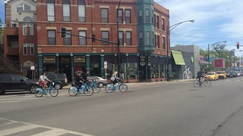
"Urban adventures are like open books, each corner and location telling a story. Exploring a city is not just a journey through streets; it's a captivating lesson in history, culture, and the vibrant tapestry of human life."
Donnie Minnick
This Photo by Unknown Author is licensed under CC BY-SA-NC

Slide 15
Three ways to use digital media to enable urban adventures
Subtitle
Subtitle
Subtitle
Add text, images, art, and videos.
Add transitions, animations, and motion.
Save to OneDrive, to get to your presentations from your computer, tablet, or phone.
Add text, images, art, and videos.
Add transitions, animations, and motion.
Save to OneDrive, to get to your presentations from your computer, tablet, or phone.
Add text, images, art, and videos.
Add transitions, animations, and motion.
Save to OneDrive, to get to your presentations from your computer, tablet, or phone.

Slide 16
Table
 | Category 1 | Category 2 | Category 3 | Category 4
Item 1 | 4.5 | 2.3 | 1.7 | 5
Item 2 | 3.2 | 5.1 | 4.4 | 3
Item 3 | 2.1 | 1.7 | 2.5 | 2.8
Item 4 | 4.5 | 2.2 | 1.7 | 7

Slide 17

THE WAY TO GET STARTED IS TO QUIT TALKING AND BEGIN DOING.
Walt Disney

Slide 18




Team
Name
Name
Name
Name
Title
Title
Title
Title

Slide 19
Timeline
Title
To start a presentation, go to the Slide Show tab, and select From Beginning.
Title
To display Presenter view, in Slide Show view, on the control bar at the bottom left select the three dots, and then Show Presenter View.
Title
During your presentation, the speaker notes are visible on your monitor, but aren't visible to the audience.
Title
Title
The Notes pane is a box that appears below each slide. Tap it to add notes.
If you don’t see the Notes pane or it is completely minimized, click Notes on the task bar across the bottom of the PowerPoint window.

Slide 20
Content
Subtitle
Subtitle
Add text, images, art, and videos.
Add transitions, animations, and motion.
Save to OneDrive, to get to your presentations from your computer, tablet, or phone.
Add text, images, art, and videos.
Add transitions, animations, and motion.
Save to OneDrive, to get to your presentations from your computer, tablet, or phone.

Slide 21



Summary
With PowerPoint, you can create presentations and share your work with others, wherever they are. Type the text you want here to get started. You can also add images, art, and videos on this template. Save to OneDrive and access your presentations from your computer, tablet, or phone.

Slide 22
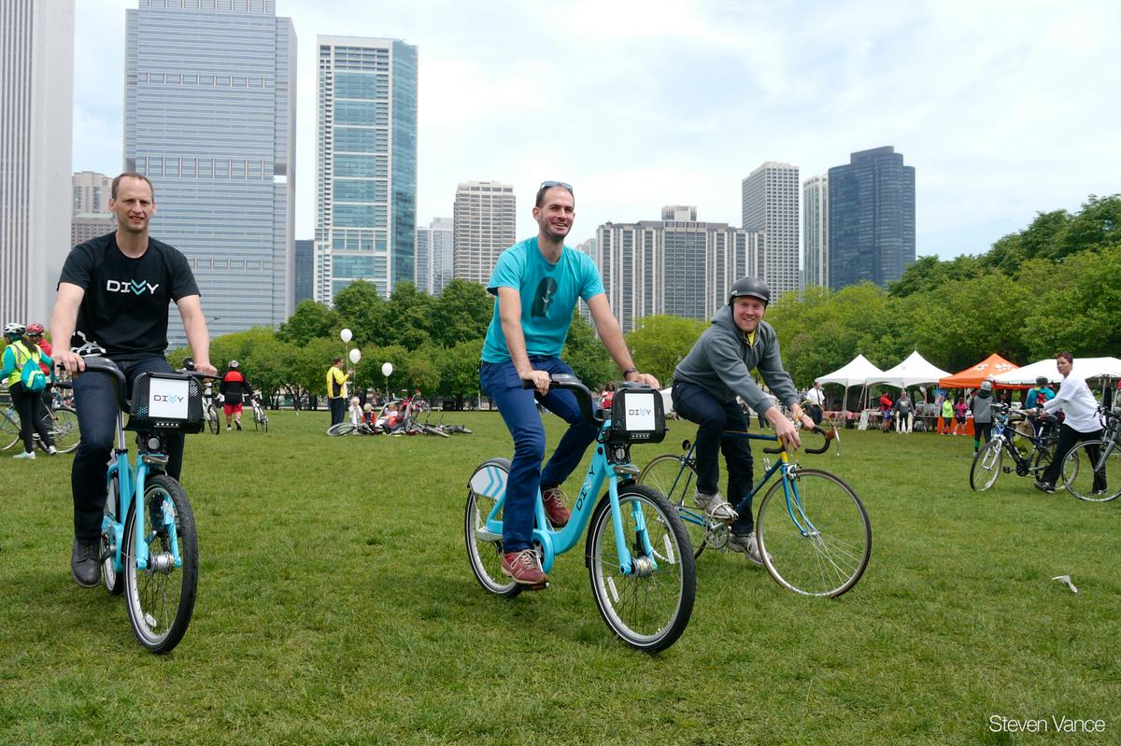

THANK YOU
Presenter Name
Email
Website

